Slide 1


Slide 2
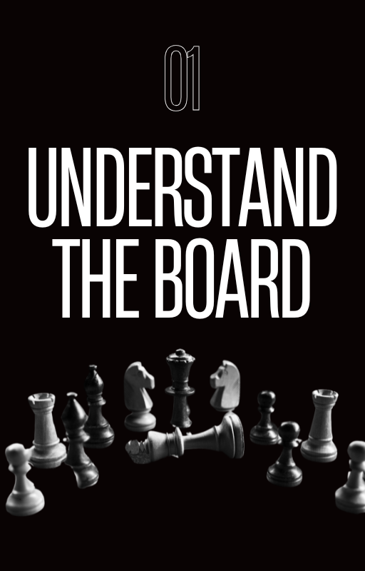

Slide 3
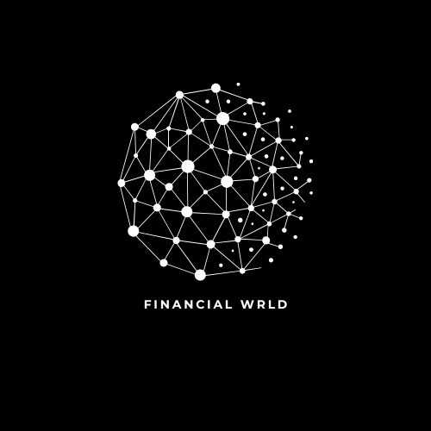
Understand the board.
Financial Diagnosis and Mindset
Before you can make any move in the financial game, you need to understand exactly where you stand on the board. This means mapping out your finances with complete clarity: how much you earn, how much you spend, and the real size of your debts. Most people don’t know exactly how much they owe or where their money goes each month — and that’s like playing chess without seeing the pieces. The first step is to have an honest and detailed financial diagnosis.
With the numbers in hand, the next move is to work on your mind. The way you see money directly influences your decisions. Beliefs like “money is hard to earn” or “investing is only for the rich” create invisible barriers that keep you stuck in the same place. Changing this mindset is essential to making smart moves. Financial education is not just about numbers; it is, above all, about behavior.
To have control of your financial game, it is essential to set goals. Short term: get out of the red. Medium term: build up a reserve. Long term: achieve financial freedom. With these clear goals, you can begin to see each choice as a strategic strategy. Spend intentionally, cut back on excesses, and allocate your resources with focus. Every small decision is important — just like every move in chess — and can change the course of the game.
Finally, adopt a tool to control your finances. It could be a simple spreadsheet, an app, or even a notebook. The important thing is to have total control. If you don’t measure, you won’t improve. Knowing your financial board is the foundation for building a solid plan. From here, you can start protecting your king (your financial well-being) and paving the way to move forward with confidence.

Slide 4


Slide 5
Protect the king
How to Get Out of Debt with Strategy
In chess, protecting the king is a priority — and in finance, the “king” is your stability. Before you think about investing or growing financially, you need to protect the essential: paying off your debts. Debts are like opposing pieces advancing on the board, consuming your resources and limiting your movements. The first step to regaining control is to organize all your outstanding debts in order of value, interest, and impact on your budget.
There are two main methods for getting out of debt: the Snowball, where you start with the smallest debts and gain motivation with each payment, and the Avalanche, which attacks the debts with the highest interest first, being more financially efficient. The ideal is to choose the strategy that you will be able to maintain consistently. The important thing is to make constant moves — always paying something, even if it is a small amount, and not stopping.
Negotiating is a powerful move. Many people do not know that debts can be renegotiated with significant discounts, especially when it comes to old debts. Banks and creditors would rather receive something than nothing, so use this to your advantage. But be careful: only make deals that actually fit within your budget. A poorly planned new installment plan could be a check in disguise.
Even while you pay off debts, start building up a small emergency fund — no matter how small. This will prevent unforeseen events from forcing you into debt again, creating an endless cycle. Getting out of debt isn't just about paying off bills, it's about changing your financial behavior pattern. Protecting your king means ensuring that you don't end up back where you started, but rather moving forward, with strategy and consistency, towards financial freedom.

Slide 6
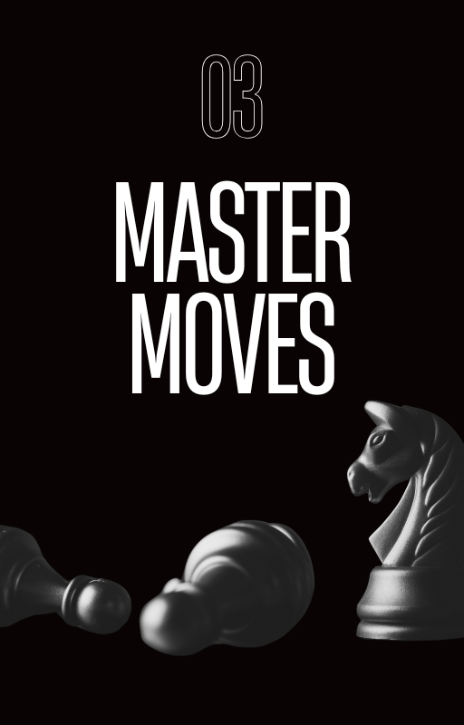

Slide 7
Master moves
Investment Fundamentals
After protecting the king, it's time to move forward intelligently. Growing financially requires more than just saving money — you need to invest. Investing is making your money work for you, multiplying resources in the medium and long term. To do this, you need to understand the difference between saving and investing. Saving is accumulating money, usually in low-yield locations, such as savings accounts. Investing is investing this money in assets that generate returns — with controlled risks.
The first concept you need to master is that of fixed income and variable income. In fixed income, such as Treasury Direct or CDBs, you know in advance how much you will receive and in how long. They are ideal for beginners. In variable income — such as stocks, real estate funds or cryptocurrencies — the gains are greater, but so are the risks. A good player does not enter a game without knowing the pieces: understand where they are putting their money.
Another essential point is to identify your investor profile: conservative, moderate or bold. This profile will guide your choices and avoid impulsive decisions, which are common traps. For beginners, it is safer to start with predictable assets while you develop knowledge and confidence. Remember: in chess and investing, patience usually beats haste.
Finally, understand the power of compound interest — the famous formula for multiplication over time. The sooner you start, the less money you need to build a significant amount of wealth. Small monthly contributions, invested consistently, can turn into big results in the future. Growing financially is not about winning a lot all at once, but about making the right moves over and over again. This is the basis of building wealth.

Slide 8
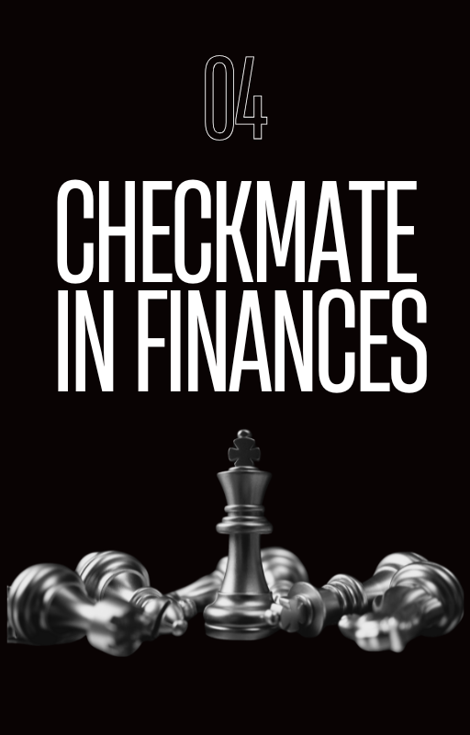

Slide 9
Checkmate in finances
High Profitability and Freedom Strategies
With debts eliminated and the first investments structured, the most awaited moment arrives: transforming your strategy into freedom. Financial checkmate happens when you build enough passive income to cover your lifestyle without depending on active work. This requires intelligence, consistency and good choices of assets with high profitability, but also with well-calculated risks. This is where the game really starts to change.
One of the key pieces at this moment are Real Estate Investment Funds (FIIs), which allow you to receive monthly rents without having to buy physical properties. In addition, shares of good companies that pay regular dividends help to build a continuous income flow. For those looking to accelerate wealth growth, it is also worth considering growth stocks and even international ETFs, which expose your assets to more stable economies and are protected against the devaluation of the local currency.
Diversifying investments is like controlling several fronts on the board: it reduces risks and increases your chances of success. At the same time, it is essential to protect what you are building with insurance, robust reserves and well-defined risk management. Financial freedom isn’t just about earning more—it’s about ensuring that you don’t lose everything in one miscalculated move. This requires discipline and a long-term vision.
Finally, establish a financial independence plan with clear goals: how much you need to accumulate, how much you want to earn each month without having to work, and how long it takes you to achieve this. Review this plan annually, make adjustments when necessary, and stay focused. In chess, the master wins not because he makes brilliant moves all the time, but because he avoids mistakes and follows his strategy precisely. In the game of finance, the logic is the same..

Slide 10


Slide 11

Congratulations
Thank you very much for getting this far! I am immensely grateful for you taking the time to read this eBook. I hope the content has been useful, inspiring, or at least made you reflect. Your reading is what gives meaning to all this work. Until the next journey!
Now that you have completed the reading, I challenge you to turn knowledge into action: 1) start investing monthly, even if it's a small amount, to create the habit; 2) record all your expenses for at least 90 days, understanding where your money really goes; and 3) set a long-term financial goal and commit to contributing to it monthly as a priority. True progress comes from consistency, and by making this commitment to yourself, you will be taking a firm step towards the financial freedom you want to build.

